Slide 1
Welcome to FinApp!
A Presentation by FinApp Chair Eric Bazail-Eimil (2023)

Slide 2
Introductions
Name
School
Year
Where You’re Joining Us From
What Kitchen Appliance Are You? (No explanations needed lol)

Slide 3
The system has some growing pains
Large growth in reserves
A stagnating revenue pool for the Student Activity Fee
Lack of consistent oversight by FinApp
The diminished role of CAB
Toxic club culture
The growth in new clubs year after year
Misuse, waste, and overspending

Slide 4
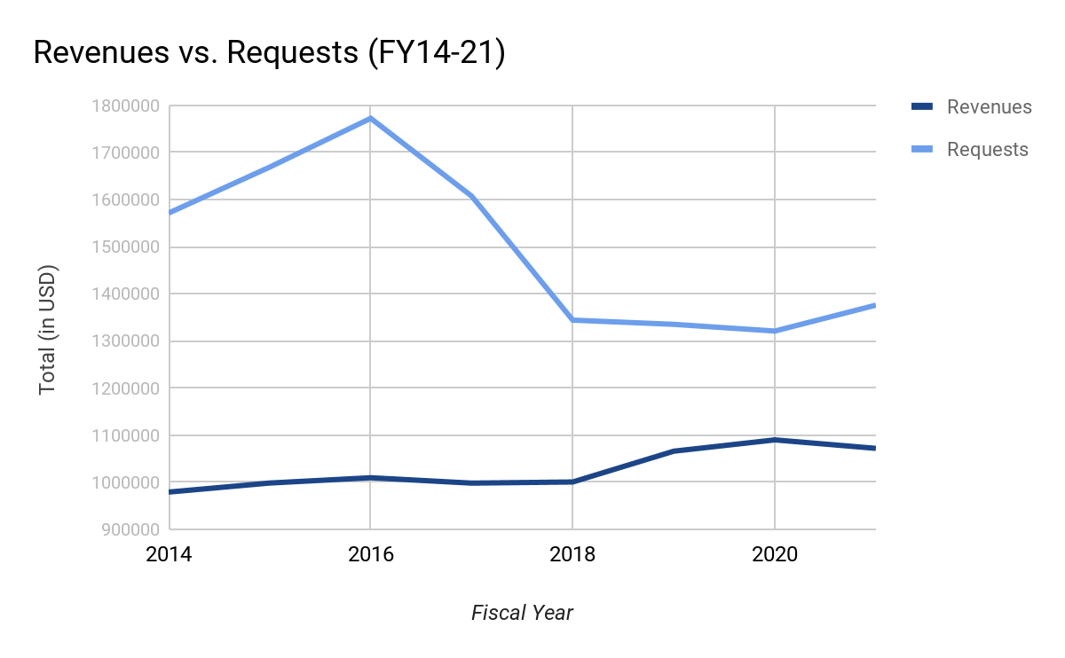

Slide 5
Agenda
Summer FinApp will be much more project-driven and more transparent
Work on
SEF
Cultural Organizations Advisory Board
SAF Reform
GUPD/GEMS/CETS Costs
Rebuilding our Relationships

Slide 6
As members of FinApp
We are not advocates for our groups, we are advocates for students and the needs of the Georgetown community
We have a responsibility to fight for students and the communities that uplift them in these times
We need to be in every outlet possible, communicating and demystifing our work.

Slide 7
Leading this Committee
Let me be crystal clear, I am not Juliana or Hayley or Chris
Goals in Leadership:
Clear expectations and honest communication
Supporting your projects and goals

Slide 8
What do we want to be?

